Slide 1
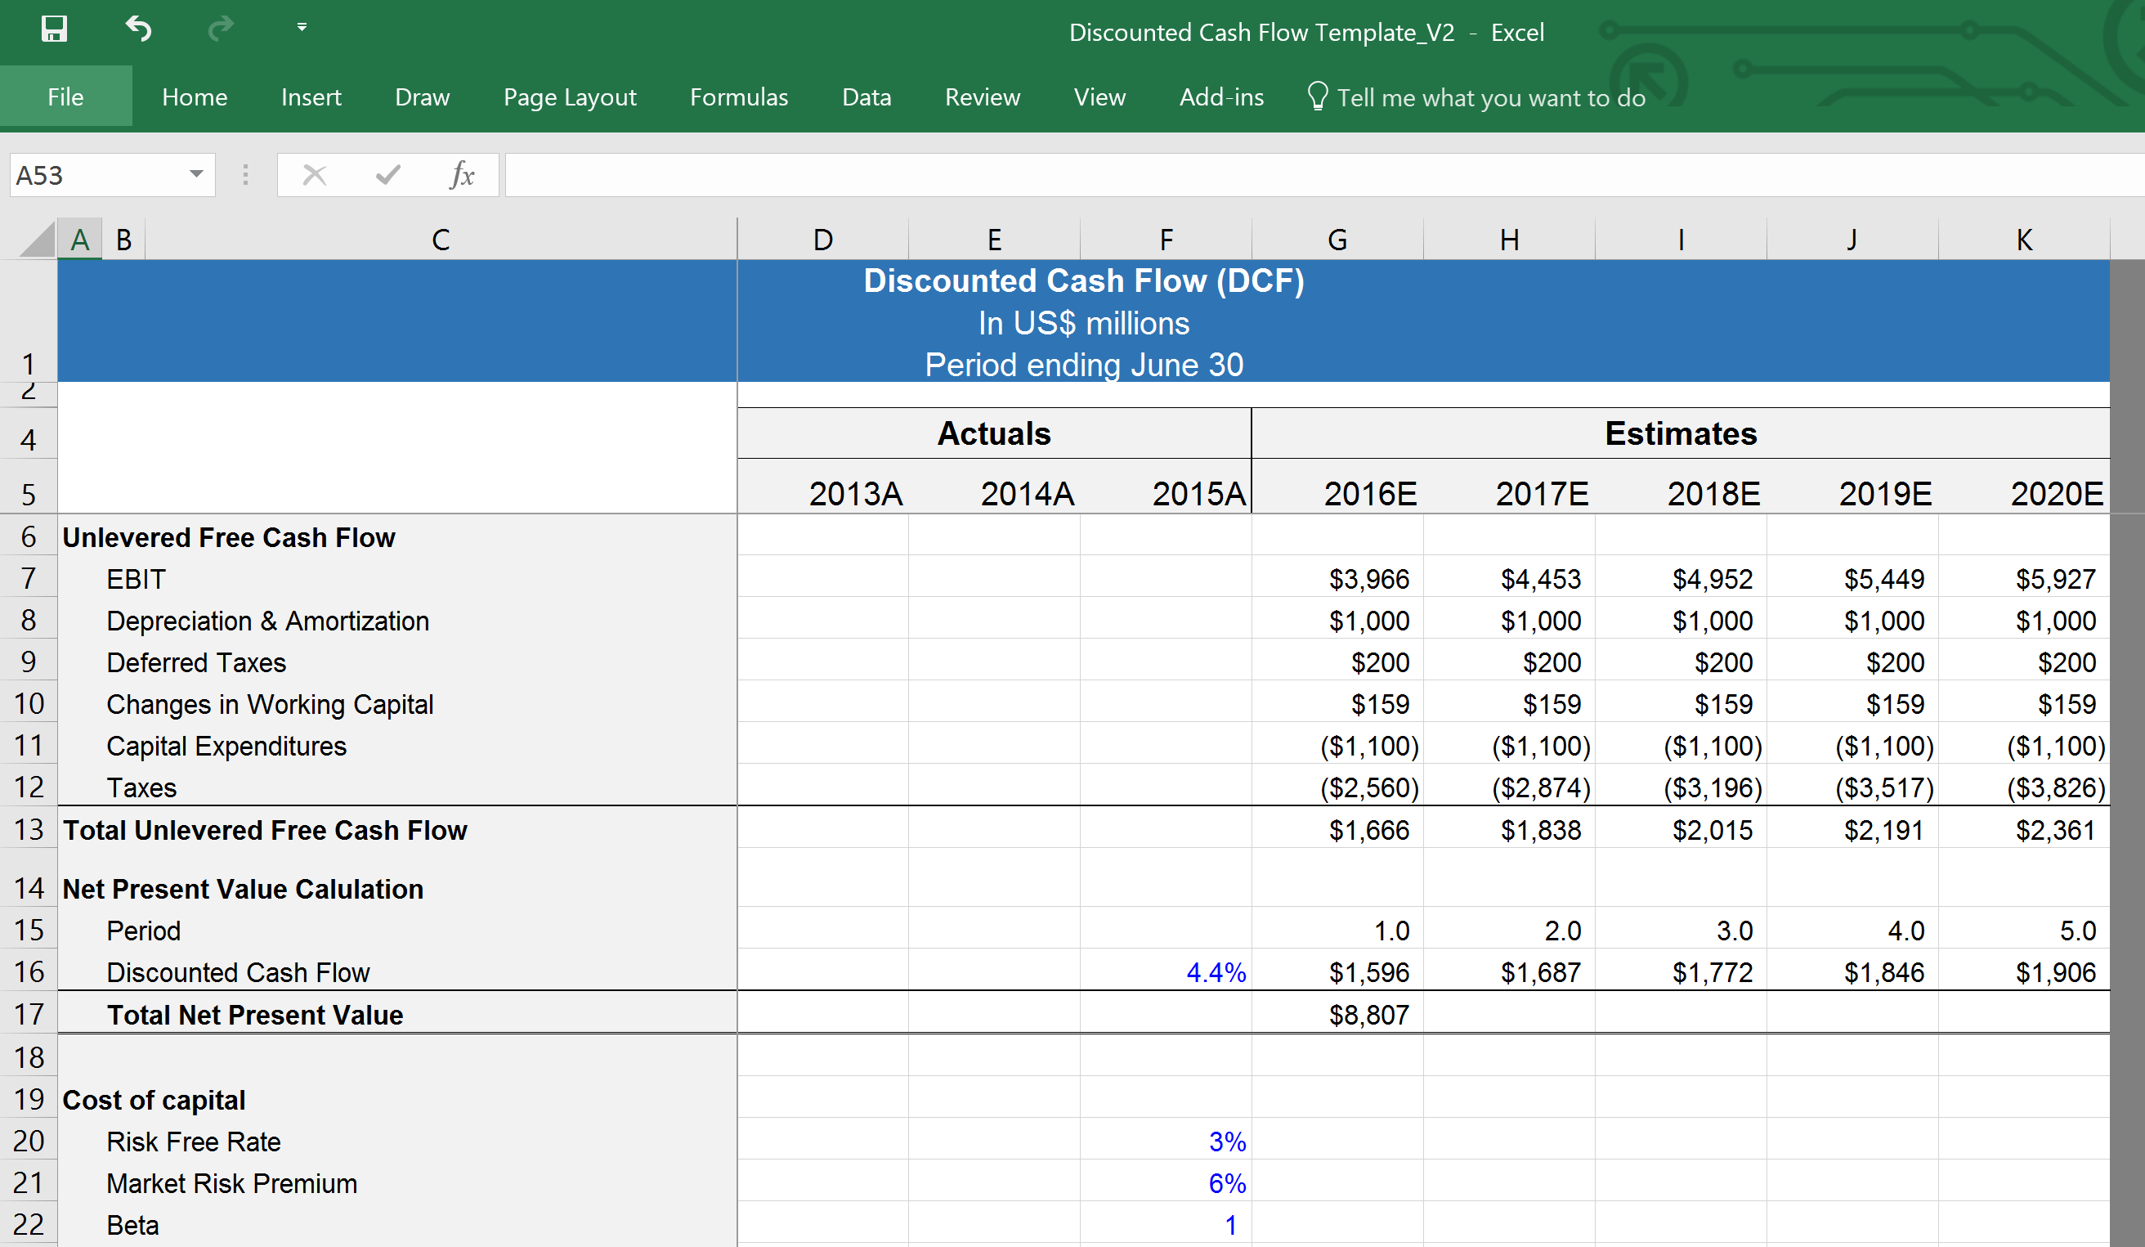
Precedent Transaction Analysis
Confidential
By Ex-Deloitte Management Consultants and Investment Bankers

Slide 2
Precedent transaction Analysis Definition
Precedent transaction analysis is a method of company valuation, where past Merger & Acquisition (M&A) transactions are used to value a comparable business today.
Commonly referred to as “precedents”, this method of valuation is often used to value an entire business as part of a merger or an acquisition.

Slide 3
A Precedent transaction Analysis can be done by following 5 simple steps
1
List potential relevant past transactions
2
Gather data for each transaction
3
Select the most relevant past transactions
4
Calculate the valuation multiples
5
Apply the valuation multiples to the company in question

Slide 4
Step 1. List potential relevant past transactions
Search for past transactions where the companies that have been purchased have many similarities with the company you are trying to value. The main criteria you need to search for are:
The industry
The type of company (public, private, etc.)
The company size in terms of revenue and employees
The types of products or services the company is selling
The deal size
The type of buyer (Competitor, private equity, public, private, etc.)

Slide 5
Step 2. Gather data for each transaction
There are many potential sources for information that can be leveraged to gather all the relevant data. For example:
Blomberg
CapIQ
Press releases
Equity research reports
Company annual reports (10K)
Company quarterly reports (10Q)
Etc.
Besides the key data mentioned in the previous slide, you’ll have to gather:
Purchase Price Market Equity Value (Market Equity Value = Share price X Number of shares)
Purchase Price Enterprise Value (Enterprise Value = Market Equity Value - Cash + Short term debt)
Sales
EBITDA
EBIT
Net Income
And finally, input the data in the blue columns of the Excel Document “Precedent Transaction Analysis_Template”. The green columns include formulas that will automatically calculate the valuation multiples.

Slide 6
Step 3. Select the most relevant past transactions
Based on all the data you gathered in the previous step, you should now be able to select only the most relevant past transactions.
In the Excel Document “Precedent Transaction Analysis_Template”, delete the entire line of each transaction that has not been shortlisted.

Slide 7
Step 4. Calculate the valuation multiples
The most common multiples for precedent transaction analysis are:
Purchase Price Market Equity Value / Net Income
Purchase Price Enterprise Value / Revenue
Purchase Price Enterprise Value / EBITDA
Purchase Price Enterprise Value / EBIT
The Excel document “Precedent Transaction Analysis_Template”, which was part of your purchase, includes in the green columns formulas that will automatically calculate:
The 4 valuation multiples mentioned above for each short-listed transaction
The average and median of each valuation multiple
The highest and lowest valuation multiple
You may decide to exclude any extreme outliers such as transactions that had EV/EBITDA multiples much lower or much higher than the average (assuming there is a good justification for doing so).

Slide 8
Step 5. Apply the valuation multiples to the company in question
After a range of valuation multiples from past transactions has been determined, those ratios can be applied to the financial metrics of the company in question.
For example, if you have:
5x EV/EBIT (low)
9x EV/EBIT (high)
…and the EBIT of the company in question is $100 million, then the valuation of the business may be somewhere between $500 million and $900 million

Slide 9

Thanks for your attention!
www.domontconsulting.com

